Slide 1
How To… Export a spectrum on the LAB-X5000

Slide 2
Exporting spectra in Test Measurement
Exporting spectra in Results

Slide 3
Exporting spectra in Test Measurement

Slide 4
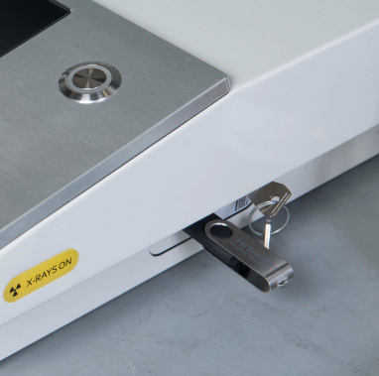

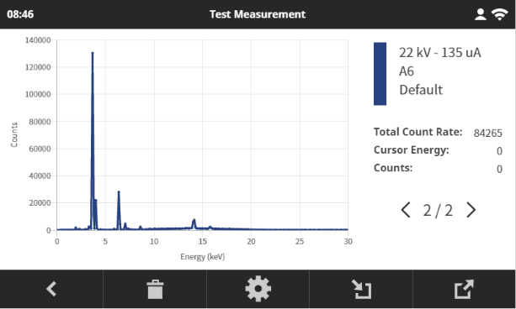
Exporting spectra in Test Measurement
What you need:
A USB memory stick.
A PC with Notepad and Excel.
Instructions:
Go to Calibration / Test Measurement.
Set measurement parameters and acquire the sample’s spectrum/spectra.
Insert the USB stick in the LAB-X USB port (located on the right hand side of the analyser).
Press the button on the LAB-X screen to export the spectrum data. If the LAB-X screen shows < X / Y > spectra, then Y spectrum files will be exported.

Slide 5
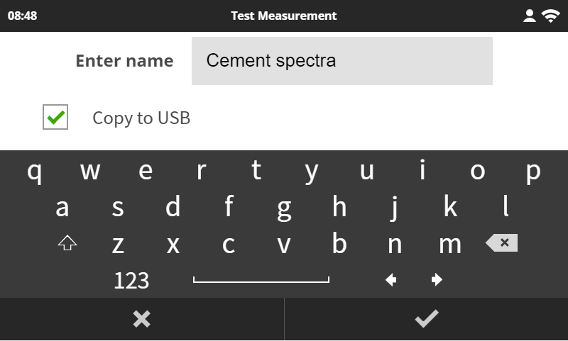
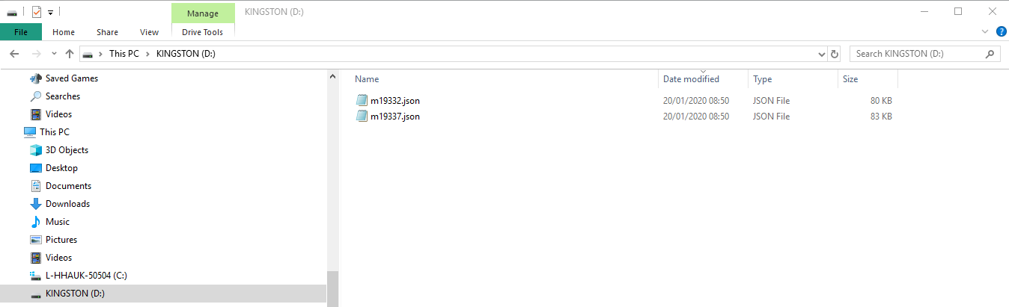
Exporting spectra in Test Measurement
Enter a name for the file, tick the “Copy to USB” box, and press to export the spectra files to the USB stick . Note: files are exported in a “Jason” format.

Slide 6
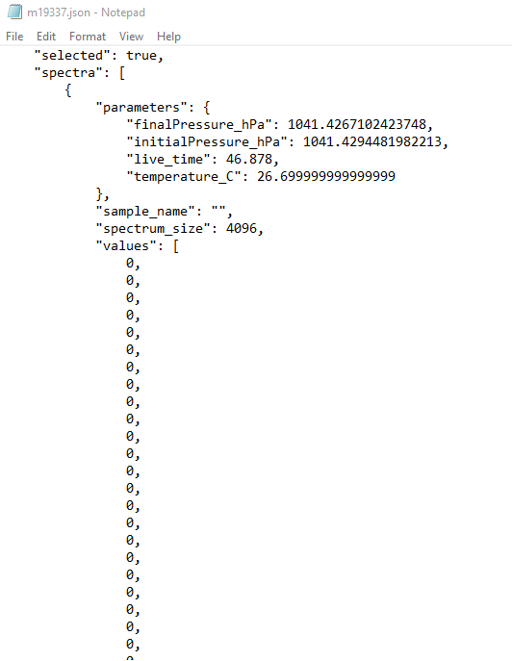
Converting Jason files in Excel
Save the Jason files to your computer.
Double click on a file. It should open in Notepad by default (if not, open Notepad, and open the file from there) .The file contains comprehensive information about the measurement. The raw spectrum data is shown as number of counts per channel (4096 data points).

Slide 7
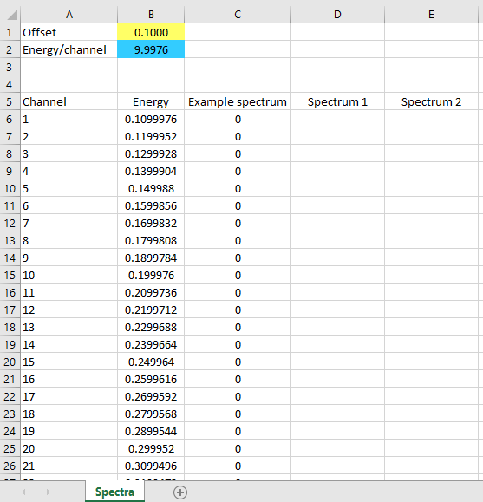
Converting Jason files in Excel
Copy all spectrum data points in the Jason file, and paste them into the “Spectrum 1” column in the “LAB-X5000 spectrum conversion” spreadsheet, as per the “Example spectrum” column.
Note: the “,” are pasted with the values. To remove them from the Excel file, use the “Find/Replace” function (Find “,”, Replace with blank value).

Slide 8
Converting Jason files in Excel
Find the offset and energy/channel information in the Jason file (see below), and enter these values in the yellow and blue cells in the spreadsheet.

Slide 9
Converting Jason files in Excel
The spreadsheet will use this data to generate the spectrum in the LAB-X5000 spectra graph.

Slide 10
Exporting spectra in Results

Slide 11
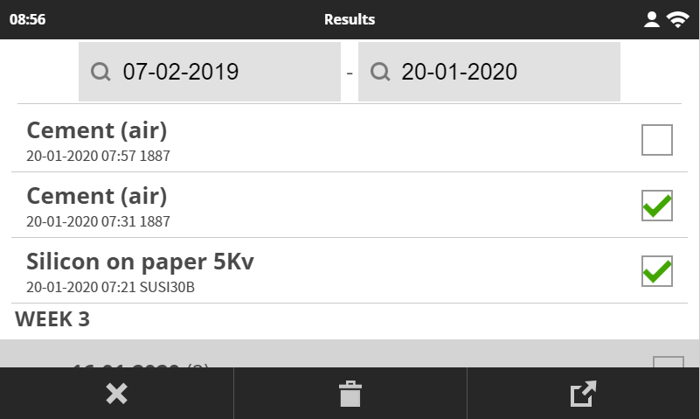
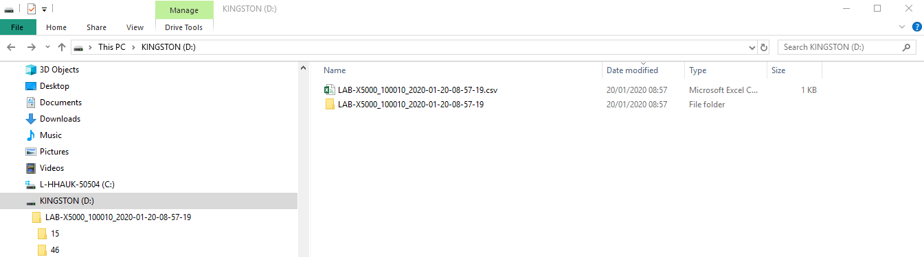
Exporting spectra in Results
Instructions:
Go to Results.
Select the samples you want spectra for.
Insert your USB memory stick in the LAB-X USB port.
Press the button on the LAB-X screen. This will export the CSV results file for the selected samples, as well as a folder containing their individual Jason files.

Slide 12
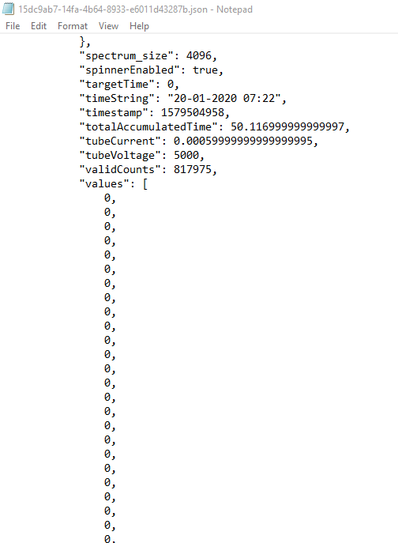
Using Jason files in Excel
Save the Jason files on your computer.
Double click on a file. It should open in Notepad by default (if not, open Notepad, then open the file from there).

Slide 13
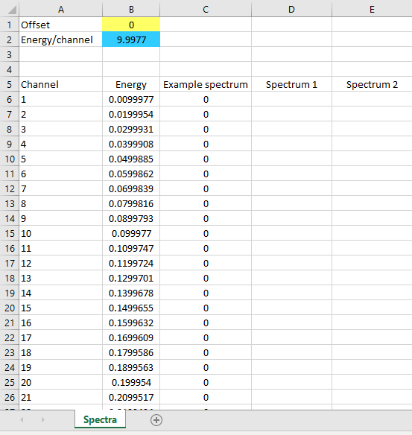
Converting Jason files in Excel
Copy all spectrum data points in the Jason file, and paste them into the “Spectrum 1” column in the “LAB-X5000 spectrum conversion” spreadsheet, as per the “Example spectrum” column.

Slide 14
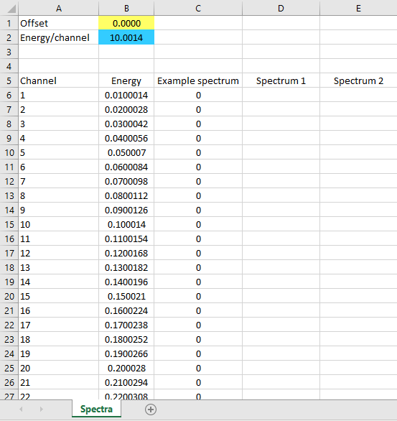
Converting Jason files in Excel
Find the offset and energy/channel information in the Jason file, and enter these values in the spreadsheet (yellow and blue cells).

Slide 15
Converting Jason files in Excel
The spreadsheet will use this data to generate the spectrum in the LAB-X5000 spectra graph.

Slide 16
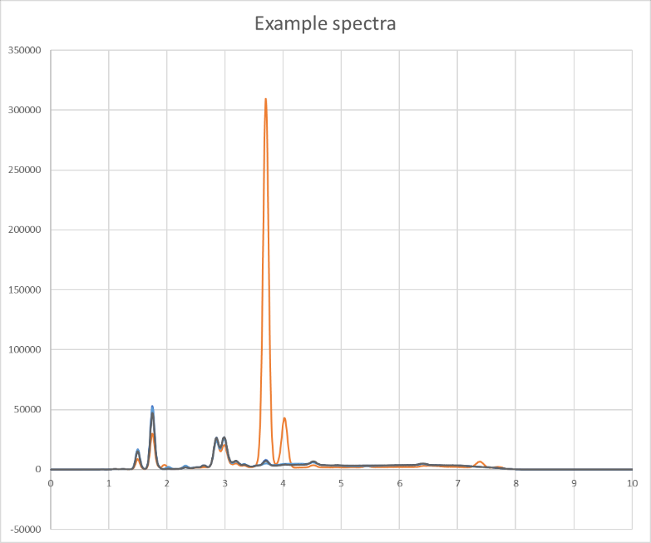
Exporting spectra
You can superimpose several spectra by using columns Spectrum 1 and Spectrum 2 in the spreadsheet, and adding new columns for additional spectra.

Slide 17
Hitachi High-Tech Analytical Science
End

